Slide 1


Department of Computer Science and Engineering
HUMAN BEHAVIOUR AND ABNORMALITY DETECTION USING SPATIO TEMPORAL AND YOLO V5
AKSHAYA.R [211419104009]
HELEN ROSHNA.A [211419104099]
NEONA JOSITA.W [211419104182]
Guide Name Coordinator Name
Mrs. K. Sangeetha, M.E., Dr. Kavitha Subramani, M.E., Ph.D.,

Slide 2
INTRODUCTION
The installation of surveillance cameras in both public and private locations, including shopping centres , airports, streets, train stations, etc., has grown significantly in recent decades as a result of the high demand for security. The primary goal of these cameras is to document and so stop ongoing deviant activity, such as assaults, car accidents, robberies, pedestrian fights, traffic jams, etc. The drawbacks of using manual labour to watch over security cameras are numerous. As a result, in order to address the aforementioned issues, it is necessary to develop a fully automated system that can recognize, learn, and notify the user to any suspicious actions in the captured video. An abnormal behaviour detection system is a system that automatically analyses, analyses, and recognizes unusual activity in security camera videos. Human objects or weapon detection and tracking are still conducted at cloud centers, as real-time, online tracking is computationally costly. For this purpose, we trained the classifier model of YOLO v5, i.e., “You Only Look Once” is model is a state-of-the-art real-time object detection classifier. Furthermore, we are not just detecting the guns, humans, and cars but also getting the location of the incident and storing the data for future use.

Slide 3
LITERATURE SURVEY
S.NO | TITLE | YEAR | ALGORITHM | AUTHOR | TECHNIQUE | MERITS AND DEMERITS
1 | “Abnormal Behavior Recognition System based on Improved CRNN Model” | 2022 | CRNN | Zheng Xu, Jingxuan Wang,Yuanyao Lu | In this paper, an adaptive video frame extraction method is proposed. A multi-branch convolutional fusion neural network is used to detect abnormal behaviour in surveillance videos and UCF-crime dataset is used. | MERITS-This method can significantly reduce the number of parameters and FLOPs of the CRNN network without reducing accuracy. DEMERITS-The accuracy is not mentioned properly.

Slide 4
S.NO | TITLE | YEAR | ALGORITHM | AUTHOR | TECHNIQUE | MERITS AND DEMERITS
2 | “Analysis of Video-based Human Activity And Detection Approaches” | 2022 | CNN | I. Gull, A. Selwal and A. Sabha | The study illustrates a generic classification for HAD methods and a paradigm shift is observed from traditional to modern deep learning-based techniques. We also provide an analysis of publicly available datasets for the classification of human activities. | MERITS-Due to problems such as camera background, motion etc, CNN are used in bulk of HAD techniques to solve these problems. DEMERITS-It needs higher software techniques.

Slide 5
S.NO | TITLE | YEAR | ALGORITHM | AUTHOR | TECHNIQUE | MERITS AND DEMERITS
3 | “Human Behavior and Anomaly Detection using Machine Learning and Wearable Sensors” | 2021 | CNN | Ioana Alexandra Bozdog, Todea Daniel-Nicusor, Marcel Antal; Claudia Antal, Tudor Cioara, Ionut Anghel, Ioan Salomie | This paper aims to identify potential anomalies in human behavior by detecting and analyzing them using a set of non-invasive wearable sensors. The results obtained using a publicly available activity dataset &various configurations of machine learning algorithms. | MERITS-Various configuration of feature selection techniques and features as well as manual labelling for supervised learning have been used. DEMERITS-The accuracy is not mentioned properly

Slide 6
S.NO | TITLE | YEAR | ALGORITHM | AUTHOR | TECHNIQUE | MERITS AND DEMERITS
4 | “Research on Human Abnormal Behavior Detection Based on Deep Learning” | 2020 | DCNN | Weihu Zhang, Chang Liu | To improve the recognition rate of abnormal human behavior in complex scenes, a mixed Gaussian model is employed to identify clear foreground moving target contours. Farneback dense optical flow algorithm is used to obtain spatiotemporal information. | MERITS-A mixed Gaussian model is used to detect clear foreground moving target contours and perform Gaussian filtering on them to remove the effects of noise in the scene. DEMERITS-It is a complex model system

Slide 7
S.NO | TITLE | YEAR | ALGORITHM | AUTHOR | TECHNIQUE | MERITS AND DEMERITS
5 | "“Detection and Recognition of Abnormal Behavior based on Multi-level Residual Network” | 2019 | ResNet | Huifang Qian, Xuan Zhou, Mengmeng Zheng | The latter is used to extract spatial features of abnormal behaviors, while the transfer learning-based recognition residual network is used to extract deep features of images to efficiently classify abnormal behaviors. | MERITS-Detection residual network is proposed to adopt multi-scale target detection strategy to ensure the detection of speed and detection effect of human body. DEMERITS-It is time consuming

Slide 8
PROBLEM STATEMENT
Human abnormal detection in video is critical to ensuring security in both internal and external spaces. People who experience high levels of violence in their neighbourhoods or through the media frequently suffer from psychological trauma. These crimes can be decreased by spotting disruptive behaviour early on and closely observing any suspicious activity so that law enforcement agencies can act right away. Human abnormality detection model give a machine the ability to recognize unsafe weapons and can also notify a human administrator when a gun or firearm is clearly visible in the vicinity. This project proposes a Spatio Temporal model and a novel regularity score based on the results of the YOLO network to detect abnormal behavior in crowd scenarios. The Spatio Temporal model extracts spatial features of video frames. In the training process, a weighted loss function is proposed based on the YOLO detection results, which emphasizes the foreground part and thus overcomes the impact of complex background. The most important and critical aspect of any application is having a desired and suitable dataset to train machine learning models on. As a result, we manually collected a massive amount of images from Google. The extraction of logical information from input video data during abnormal behaviour detection can be seen as a high-level image processing operation. To track the movement of moving objects in the videos, object detection algorithms are used. When there is a threat, a alert message goes off, occasionally alerting people to suspicious behaviour. In future, inorder to detect any weapon or dangerous objects, our proposed system can also be integrated into surveillance and security robots.

Slide 9
DEVELOPMENT ENVIRONMENT
HARDWARE REQUIREMENTS
System : Pentium i3 Processor
Hard Disk : 500 GB
Monitor : 15’’ LED
Input Devices : Keyboard, Mouse
Ram : 4 GB
SOFTWARE REQUIREMENTS
Operating system : Windows 10
Coding Language : Python
IDE : Anaconda prompt

Slide 10
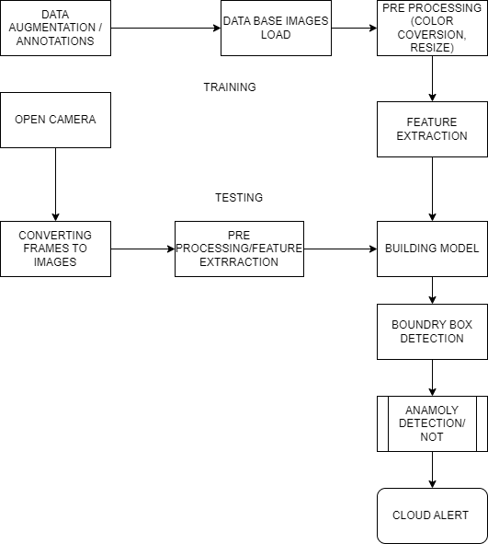
SYSTEM ARCHITECTURE

Slide 11
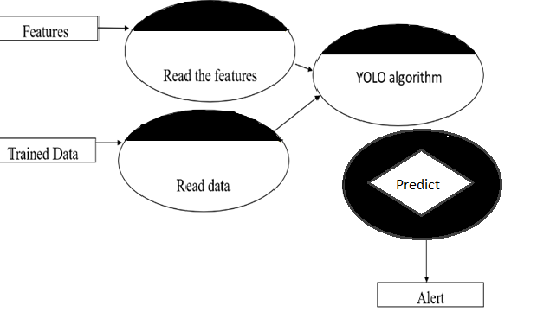
SYSTEM DESIGN
DATAFLOW DIAGRAM

Slide 12
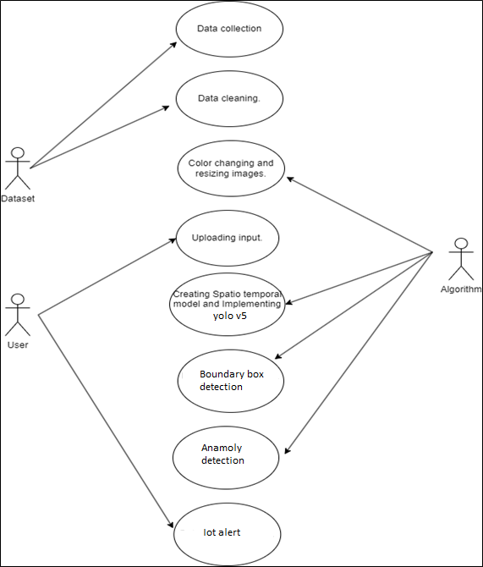
UML DIAGRAMS
USECASE DIAGRAM

Slide 13
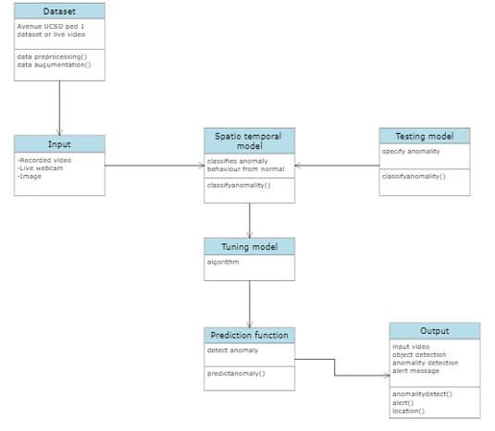
CLASS DIAGRAM

Slide 14
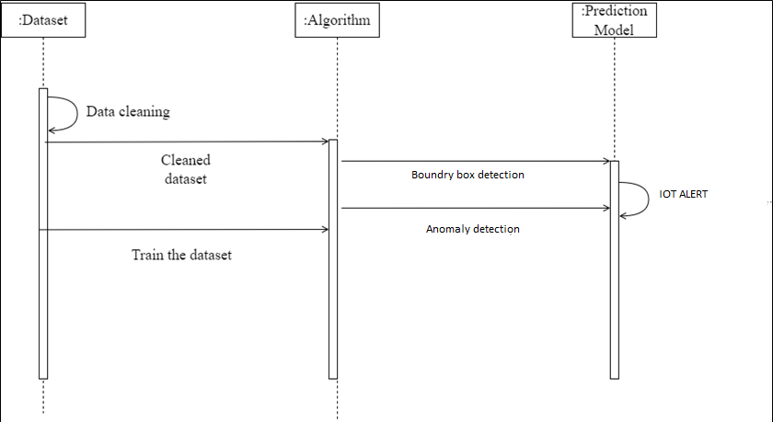
SEQUENCE DIAGRAM

Slide 15
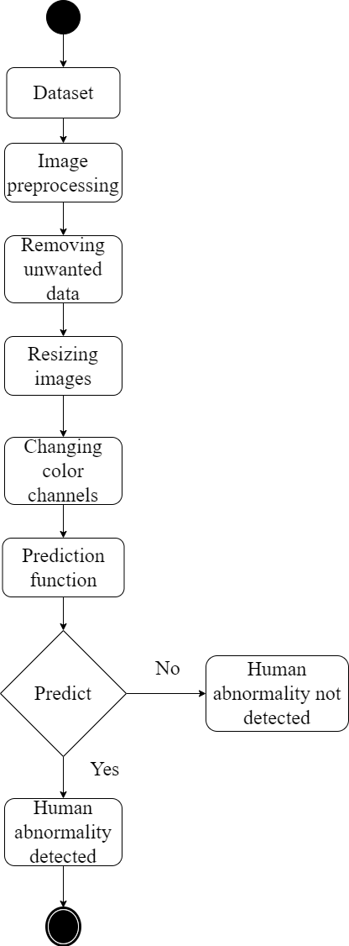
ACTIVITY DIAGRAM

Slide 16
MODULE DESCRIPTION
1. DATASET COLLECTION
We captured every 10 frames using the Avenue UCSD Ped1 and Ped 2 dataset that we obtained from Kaggle.
Avenue Dataset includes 21 video clips for assessment and 16 for training.
2. DATA PREPROCESSING
Data preprocessing changes the data into a format that can be processed in data mining, machine learning, and other data science tasks more quickly and efficiently. Each extracted frame is resized to 227x277.
All pixel values are scaled between 0 and 1 so that to make all input image frames on same level. Normalization is performed by subtracting every frame from global mean image which is formulated as
Global Mean Image= X/Y
Dataset | Type | Number of images
Train | USCD Ped 1 | 479
 | USCD Ped 2 | 383
 | Total | 862
Test | USCD Ped 1 | 115
 | USCD Ped 2 | 75
 | Total | 190

Slide 17
3. DATA AUGMENTATION
Data augmentation is a technique of artificially increasing the training set by creating modified copies of a dataset using existing data. It includes making minor changes to the dataset or using deep learning to generate new data points.
Change the color channel: We'll convert the frames' RGB colour channel to GreyScale. A grayscale image is one in which each pixel's value is a single sample carrying just information about the intensity of the light. Resizing the frame: We will resize the frames to a size of 227x227px.
4. BUILDING MODEL-TRAINING
We will create a Spatio Temporal Model with the Yolov5 model, using Convolution layers to build our model.
YOLOv5 is natively implemented in PyTorch, eliminating the Darknet framework’s limitations (based on C programming language). Its is an object detection model. In this project, we make its as custom dataset. This massive change of YOLO to the PyTorch framework made it easier for the developers to modify the architecture and export to many deployment environments straightforwardly.

Slide 18
5. CLASSIFICATION
A collection of predefined classes that the algorithm was trained for are used by image classification algorithms to predict the type or class of an object in an image. Typically, input consists of an image of a singular object, like a cat. Output is a class or label that designates a specific item, frequently with a probability attached to it.
Using bounding boxes, object localization algorithms identify the existence of an object in the image. They use the position, height, and width of the objects in the input picture to determine the location of one or more bounding boxes.
Image classification: Algorithms produce a list of object categories present in the image.
Object detection: Algorithms produce a list of object categories present in the image along with an axis-aligned bounding box indicating the position and scale of every instance of each object category.
6. PREDICTION DETECTION-TESTING
Prediction methods are used to detect anomalous events by comparing them to their predicted values. We will create Prediction function to detect anomaly in a video. The next step is to create a function that can evaluate inputs such as images, videos, and times to determine if they are anomalous or not. Using the Python predict() method, we can forecast the labels of the data values based on the trained model.

Slide 19
PERFOFRMANCE EVALUATION
RESULT AND DISCUSSION
Both recorded and live videos can be used to spot unusual activity. An alert text message with the location of the detection is sent to the user if an unusual activity or weapon is discovered. Additionally, the user receives an email with the location and an image of the abnormal activity. It can also identify people and other objects in the video, but an alert message will only be sent if abnormal activity is discovered. The project heavily relies on object detection. Receiving alert messages with location information ensures high security and quick response to threats.
ACCURACY PREDICTION
The graph demonstrates that our suggested method outperforms the majority of semi-supervised methods in terms of stability and accuracy. Additionally, our suggested method's internal group convolution structure makes it simpler to adapt our method to various data sets. To support this claim, more research and data are required. When the data set gets bigger and better in the future, we think our methodology will perform better. To show the effectiveness and precision of the suggested model, the precision of the accepted techniques in the area of perceiving anomalous behavior following the model's evaluation and testing, we applied our suggested algorithm to the Avenue UCSD-Ped 1 dataset and carried out training and testing.

Slide 20
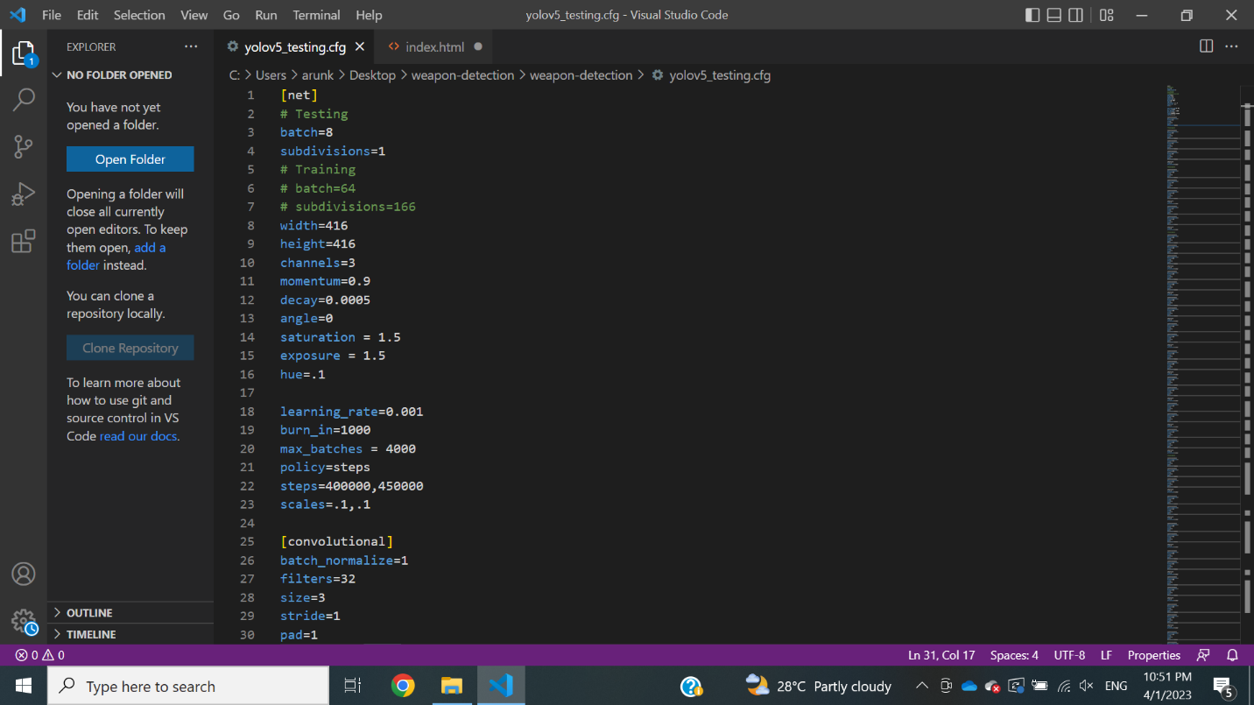
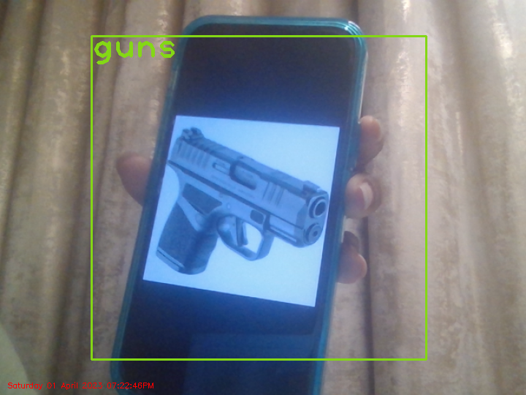
SCREENSHOTS
1. Yolo Testing
2. Detection of weapon through web camera

Slide 21
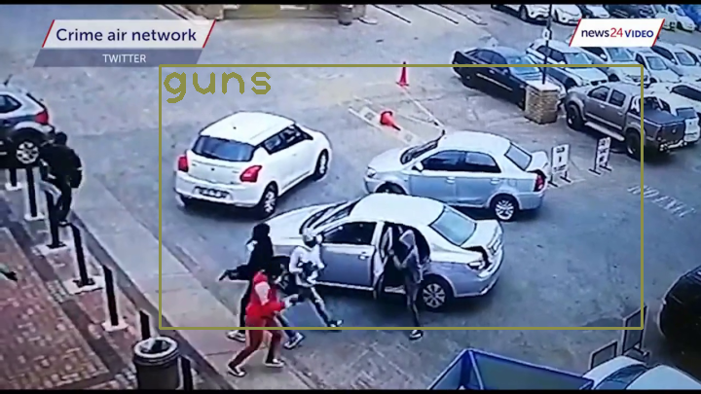
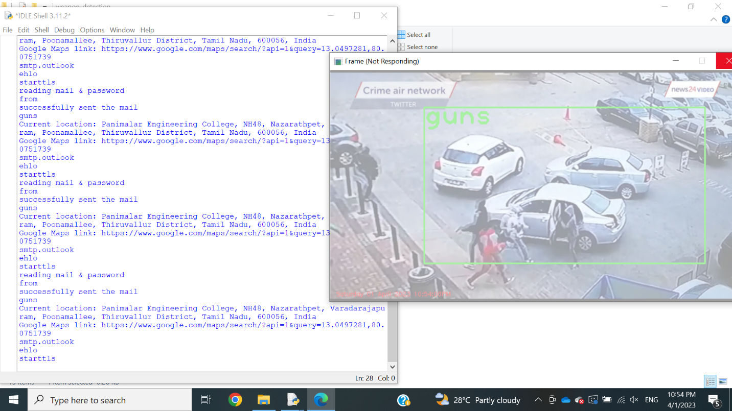
3. Detection of weapon in a recorded video
4. Output

Slide 22
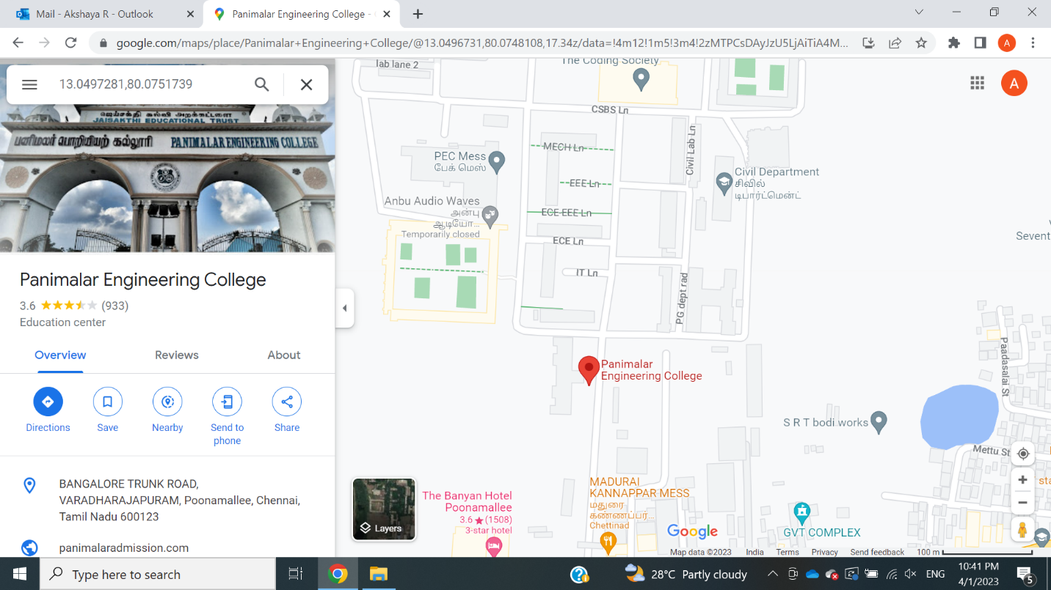
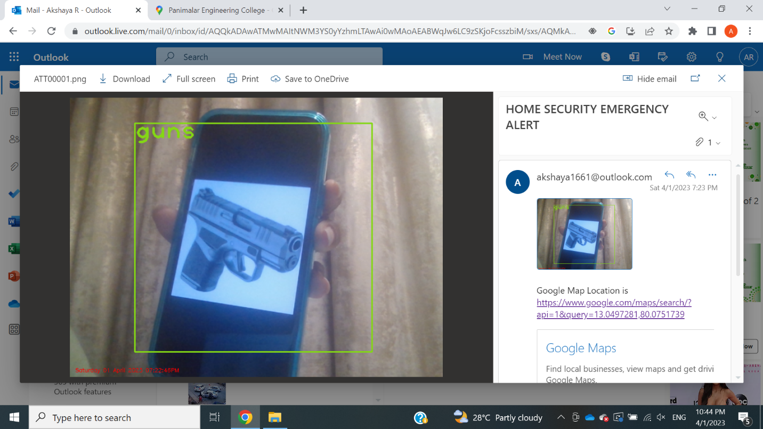
5. Location of the camera
6. Email received after detecting a weapon in a live video

Slide 23
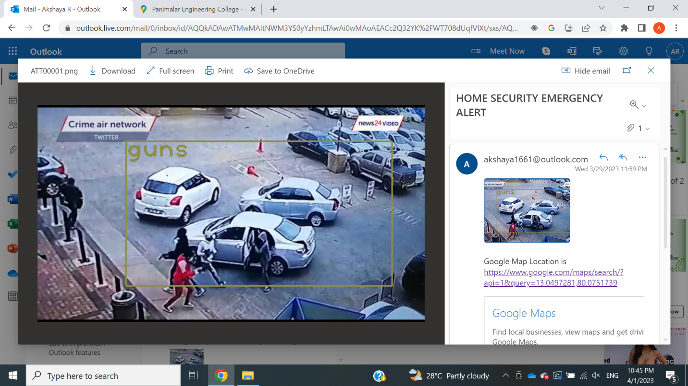
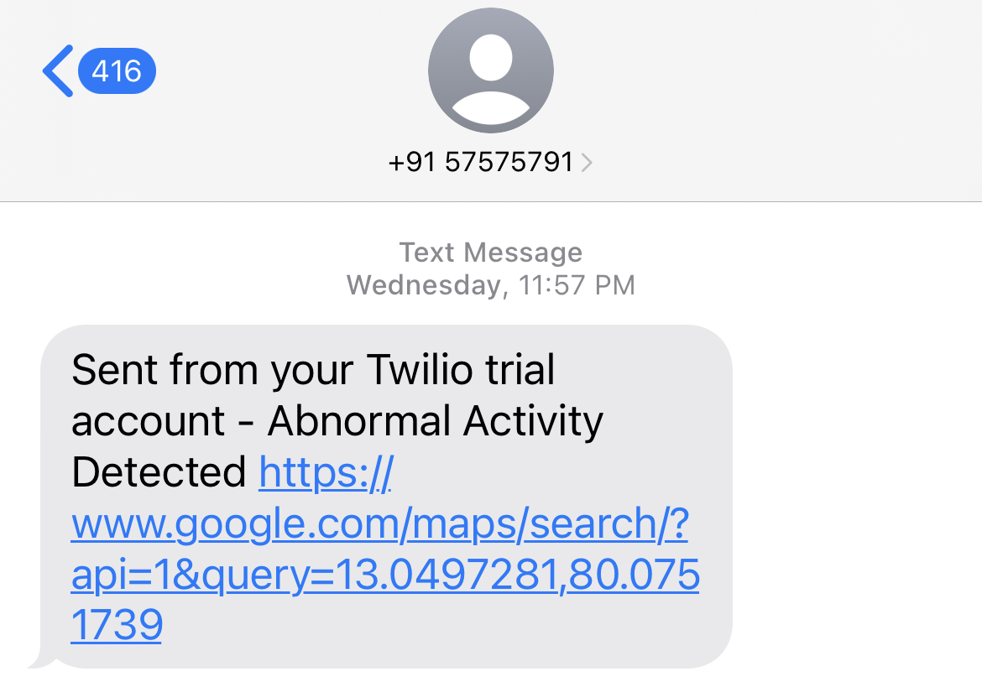
7. Email received after detecting weapon in a recorded video
8. SMS notifying the detection

Slide 24
CONCLUSION
In this study, the state-of-the-art YOLO V5 object detection model was implemented and trained over our collected dataset for weapon detection. We propose a model that provides a visionary sense to a machine to identify the unsafe weapon and can also alert the human administrator when a gun or a firearm is obvious in the edge. Experimental results show that the trained YOLO V5 has better performance compared to the YOLO V3 model and more or less costs the same computationally. There is an immediate need to update the current surveillance capabilities with improved resources to support monitoring the effectiveness of human operators. Smart surveillance systems would fully replace current infrastructure with the growing availability of low-cost storage, video infrastructure, and better video processing technologies. Eventually, the digital monitoring systems in terms of robots would fully replace current surveillance systems with the growing availability of cheap computing, video infrastructure, high-end technology, and better video processing.

Slide 25
REFERENCES
Ioana Alexandra Bozdog, Todea Daniel-Nicusor, Marcel Antal; Claudia Antal, Tudor Cioara, IonutAnghel, IoanSalomie, “Human Behavior and Anomaly Detection using Machine Learning and Wearable Sensors”, IEEE 17th International Conference on Intelligent Computer Communication and Processing (ICCP), 2022
Huifang Qian, Xuan Zhou, Mengmeng Zheng, “Detection and Recognition of Abnormal Behavior based on Multi-level Residual Network”, IEEE 4th Advanced Information Technology, Electronic and Automation Control Conference (IAEAC), 2020
Weihu Zhang, Chang Liu, “Research on Human Abnormal Behavior Detection Based on Deep Learning”, International Conference on Virtual Reality and Intelligent Systems (ICVRIS), 2021
Federico Angelini, Jiawei Yan, Syed Mohsen Naqvi, “Privacy-preserving Online Human Behaviour Anomaly Detection Based on Body Movements and Objects Positions”, IEEE International Conference on Acoustics, Speech and Signal Processing (ICASSP), 2019
Thomas Gatt, Dylan Seychell, AlexieiDingli, “Detecting human abnormal behaviour through a video generated model”, 11th International Symposium on Image and Signal Processing and Analysis (ISPA), 2019

Slide 26
Rongyong Zhao, Yan Wang, Ping Jia, Cuiling Li, Yunlong Ma, Zhishu Zhang, “Abnormal Human Behavior Recognition Based on Image Processing Technology”, IEEE 5th Advanced Information Technology, Electronic and Automation Control Conference (IAEAC), 2021
Shih-Chung Hsu, Cheng-Hung Chuang, Chung-Lin Huang, Por-Ren Teng, Miao-Jian Lin, “A video-based abnormal human behavior detection for psychiatric patient monitoring”, International Workshop on Advanced Image Technology (IWAIT), 2018
Yuan Cao, Hao Xu, Qiang Yang, “Computer-vision-based abnormal human behavior detection and analysis in electric power plant”, 33rd Chinese Control and Decision Conference (CCDC), 2021
Yixue Hao, Zaiyang Tang, Bander Alzahrani, Reem Alotaibi, Reem Alharthi, Miaomiao Zhao, Arif Mahmood, “An End-to-End Human Abnormal Behavior Recognition Framework for Crowds With Mentally Disordered Individuals”, IEEE Journal of Biomedical and Health Informatics ( Volume: 26, Issue: 8, August 2022), 2021
Yimin DOU, Cai Fudong, Jinping LI, Cheng Wei, “Abnormal Behavior Detection Based on Optical Flow Trajectory of Human Joint Points”, Chinese Control And Decision Conference (CCDC), 2019

